Slide 1
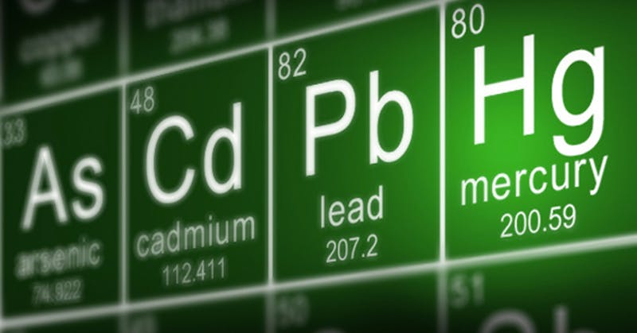
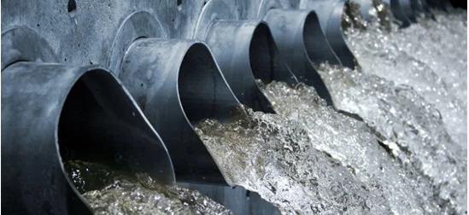

Removal of heavy metals from wastewater by polymers
Notes:
What is a heavy metal? Well, a heavy metal can be defined as many things but typically, they are a group of metals found in periods 4 and beyond, spanning from groups 3 to 16 of the periodic table. Heavy metals, at large concentrations are extremely toxic, affecting both human life and wildlife.
Inhalation and ingestion of such metals can lead to an increased risk in health, exasperating respiratory issues and increasing the risk of cancer. Industrial waste, leading to wastewater and water pollution, carry these heavy metals which then build up in these aquatic environments and harm marine life and biodiversity.

Slide 2
Introduction
Heavy metals, dubbed as such due to their high densities, are comprised of a block of all the metals in groups 3 to 16 of the periodic table that are in periods 4 and greater (the transition and post-transition metals) (Hawkes, 1997). Among these, heavy metal ions such as Cd2+, Pb2+, and Cu2+ are recognised as highly toxic pollutants. The growing presence of heavy metals in bodies of water globally poses a significant harm to human health and environmental and economic activities. Research shows that the total concentrations of heavy metal pollution is at their lowest in the 1970s and 1980s and at their highest in 21st century; the declining order of mean concentration over five decades for Cd was 1990 > 2010s > 2000s > 1970s > 1980s. (Zhou, et al., 2020). With the increasing rise in industrial waste, heavy metal contamination in aquatic environments is a growing concern. This has amplified the need for development of processses to treat wastewater efficiently. This article explores the use of polymers in heavy metal removal, looking into future advancements and the challenges that optimisation of these polymer-based composites must navigate.

Slide 3
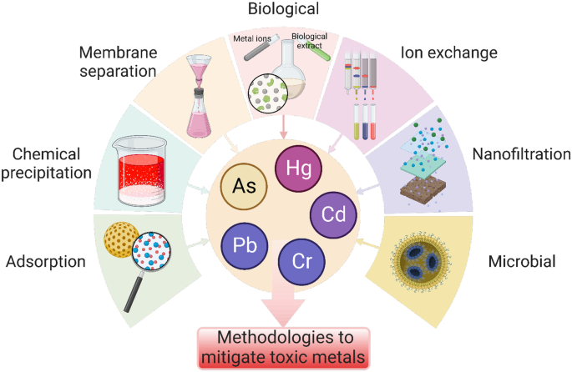
Methods of removal of heavy metals
Notes:
There are many

Slide 4
Conclusion
Heavy metal contamination of water remains a global concern, driven by industrial activities and inadequate wastewater management worldwide. The use of polymers for the treatment of wastewater has proven to be an effective, ecological and inexpensive method. Their ability to bind to heavy metals through multiple mechanisms and their structural versatility makes them a valuable tool in water management. Ongoing research aims to improve their already impressive performance by enhancing their adsorption capacity and selectivity, such as polymer nanocomposites, providing a promising advancement in this field. However, their complex synthesis and scalability challenges their ability to be produced at large scales.

